Slide 1
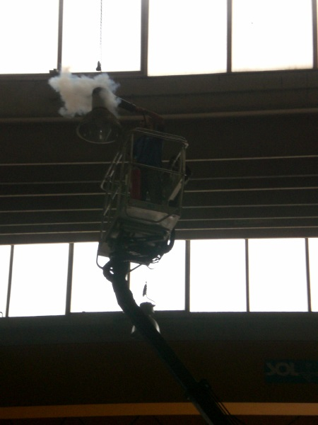
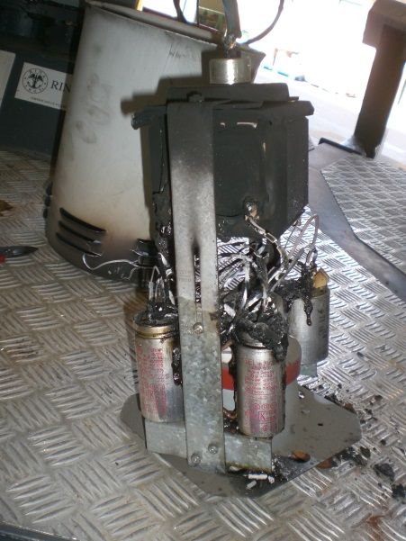
HS&E INCIDENT BULLETIN |  | 1st half year 2014
Location Country | Type of incident (example: Slip-Trip, Fall from Height, Vehicle , Laceration, Chemical Exposure)
Summary:
Event of fire on lighting installed in the test area
Root Causes: | Actions Taken Thus Far: Next Steps
Breakdown of internal insulation plastic | Evaluation replacement older lighting with more efficient and safety types

